Slide 1
Modeling and Control of a Hybrid Wheeled Jumping Robot
Elective in Robotics – Underactuated Robots
A.Y. 2020/2021
Professors
Giuseppe Oriolo
Leonardo Lanari
Supervisor Filippo Smaldone
Candidates
Rossella Bonuomo, 1923211
Marco Pennese, 1749223
Veronica Vulcano, 1760405

Slide 2
01
02
Table of Contents
03
05
Introduction
Description and goal of the project
Model
Phase 0 and VL-WIP models
Controls
MPC and PD controllers
04
Experiments
Tests and results
Conclusion
Final comments

Slide 3

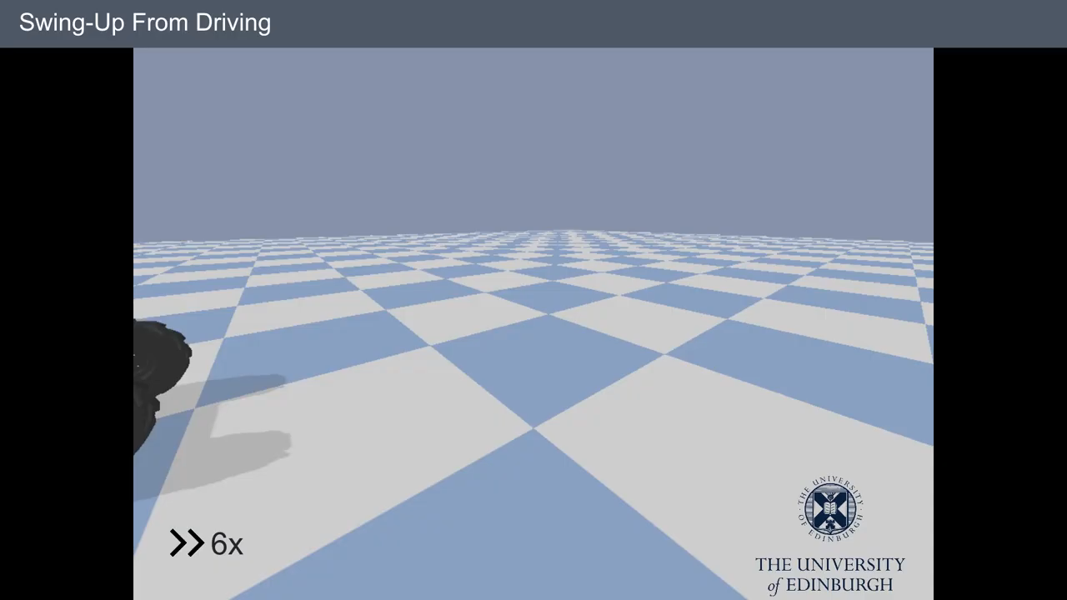
Introduction
We apply Model Predictive Control to a wheeled robot with a prismatic extension joint, that can be considered a wheeled-legged system.
These systems can combine the benefits of both mobile robots and legged systems.
After showing the system dynamics, we propose a scenario in which the robot should swing-up and balance, drive upright and jump over a gap under the control of the MPC.
We also consider a PD controller in order to make a comparison between the two approaches. To test robustness of both controller, we have also included noise in sensor’s reading.

Slide 4
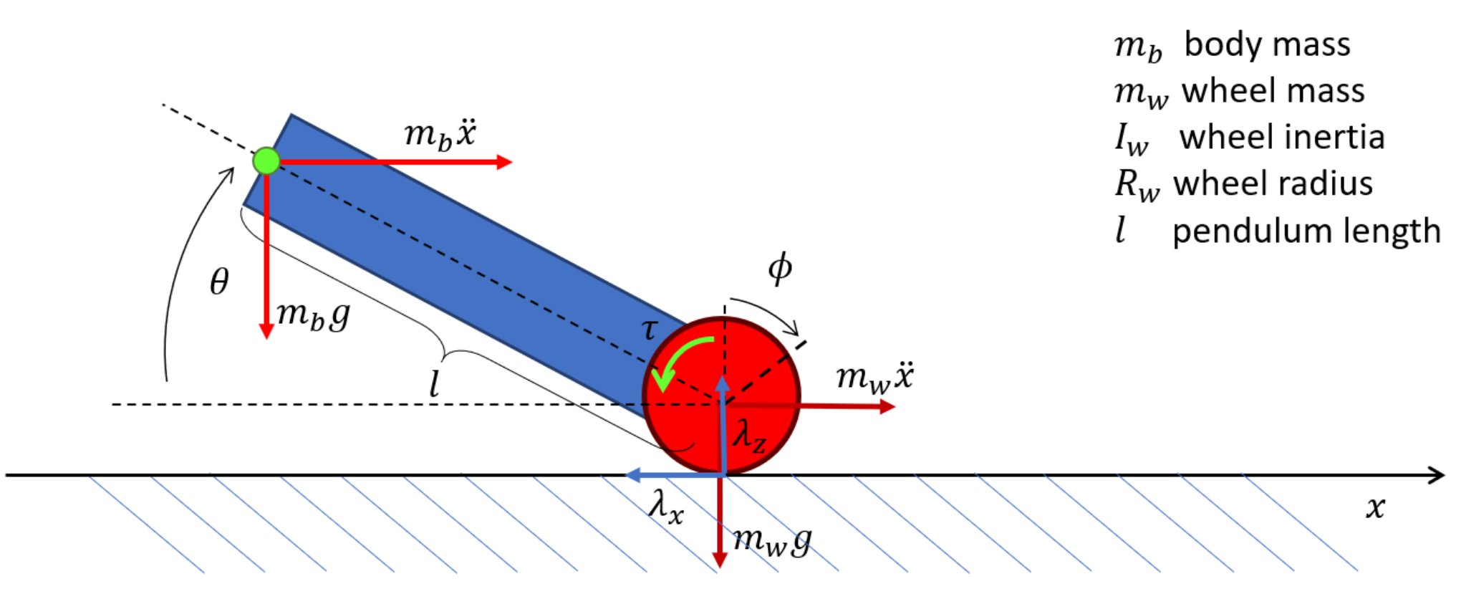
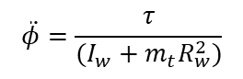
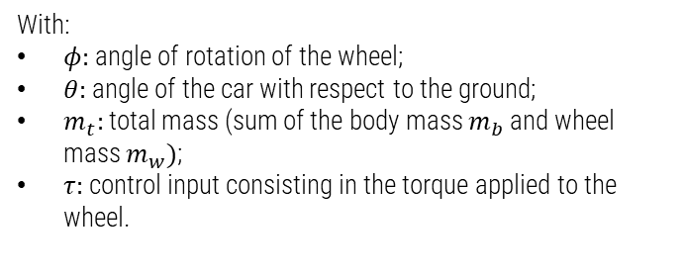
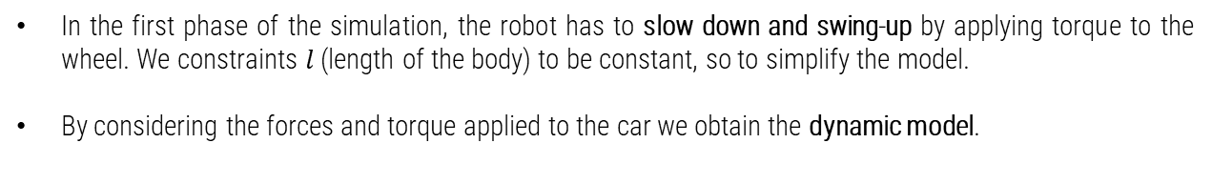
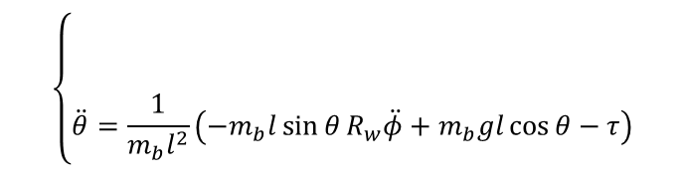
Phase 0 Model
In the first phase of the simulation, the robot has to slow down and swing-up by applying torque to the wheel. We constraints $l$ (length of the body) to be constant, so to simplify the model.
By considering the forces and torque applied to the car we obtain the dynamic model.
$$\left\{\begin{aligned} \\ \\ \\ \ddot{θ}=\frac{1}{m_{b}l^{2}}\left(−m_{b}l\sin{θ}R_{w}\ddot{φ}+m_{b}gl\cos{θ}−τ\right)\end{aligned}\right.$$
$$\ddot{φ}=\frac{τ}{(I_{w}+m_{t}R_{w}^{2})}$$
With:
$φ:$ angle of rotation of the wheel;
$θ:$ angle of the car with respect to the ground;
$m_{t}:$total mass (sum of the body mass $m_{b}$ and wheel mass $m_{w})$;
$τ:$control input consisting in the torque applied to the wheel.

Slide 5
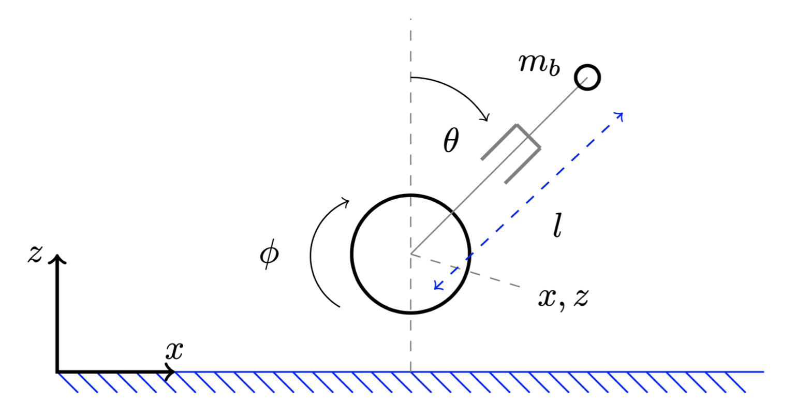
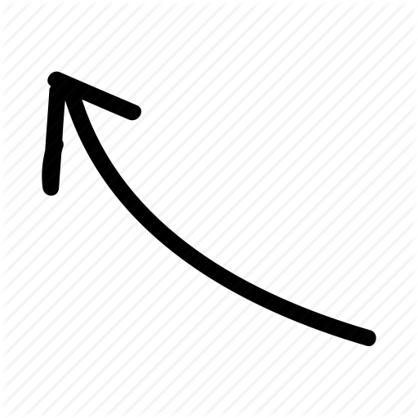
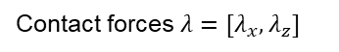

Variable-Length Wheeled Inverted Pendulum
It consists of a wheel and a pole modeled as a point mass located at a certain distance from the wheel.
The prismatic joint has to mimic the capability of a leg. The distance of the point mass to the wheel is not constant.
The generalized coordinates are $q=[\begin{matrix}x & z & {\begin{matrix}φ & l & θ]\end{matrix}}^{T}\end{matrix},$ the control inputs are $u={\left[\begin{matrix}τ & f\end{matrix}\right]}^{T}$
The dynamic model, derived through the Lagrangian method, is:
$$M\left(q\right)\ddot{q}+C\left(q,\dot{q}\right)\dot{q}+G\left(q\right)u=S^{T}u+J_{c}^{T}λ$$
Contact forces $λ=[λ_{x},λ_{z}]$
Inertia matrix
Gravity vector
Contact Jacobian
Coriolis matrix
Selection matrix

Slide 6
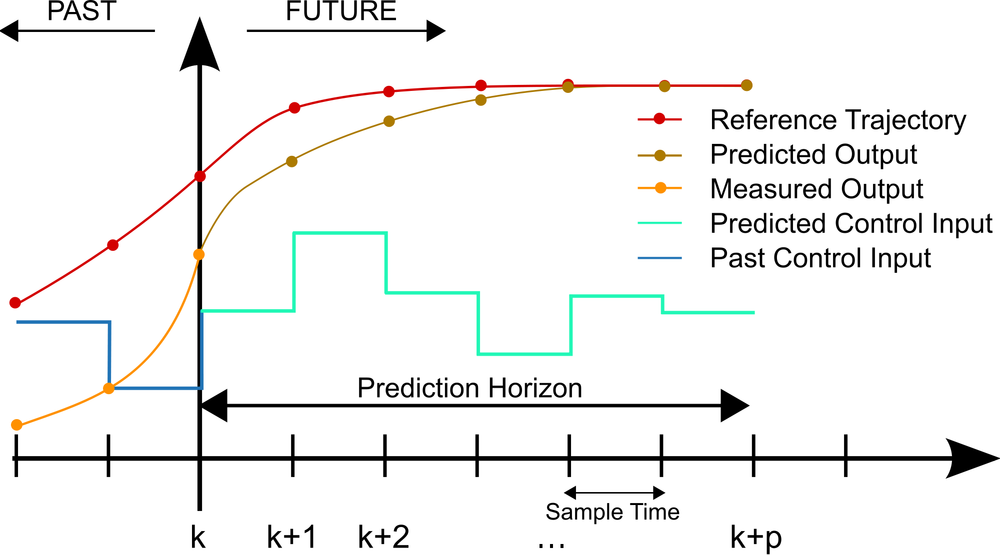

Model Predictive Control
MPC includes a family of control methods for achieving optimal performance while satisfying a set of constraints.
The optimal control action is found by solving an optimization control problem over a finite prediction horizon.
The cost function is minimized considering the process dynamics along the horizon.
We want to control the system during different phases:
Swing-up and balance
Driving upright
Jumping over a gap

Slide 7
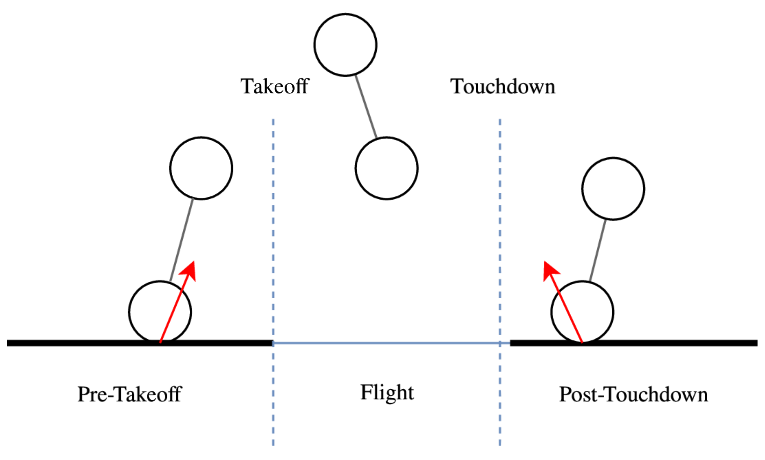
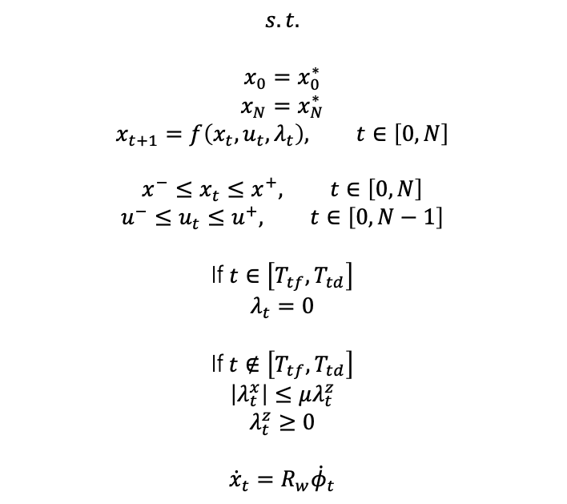
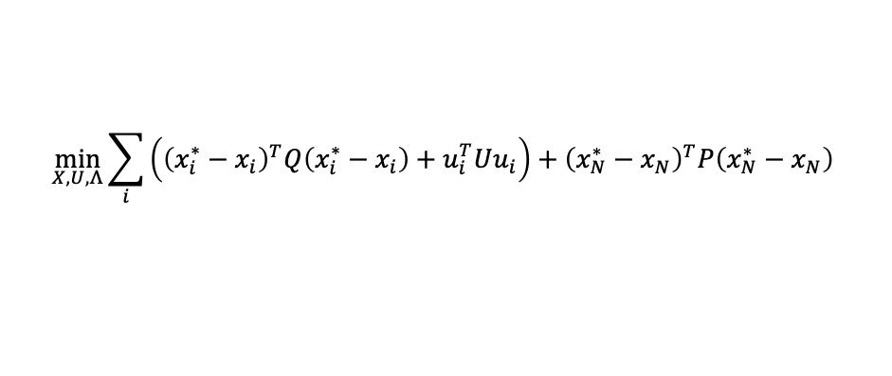
MPC – Problem formulation
$$\min_{X,U,Λ}{\sum_{i}{\left({\left(x_{i}^{∗}−x_{i}\right)}^{T}Q\left(x_{i}^{∗}−x_{i}\right)+u_{i}^{T}Uu_{i}\right)}+{\left(x_{N}^{∗}−x_{N}\right)}^{T}P\left(x_{N}^{∗}−x_{N}\right)}$$
Cost function
$$s.t.$$
$$x_{0}=x_{0}^{∗}$$
$$x_{N}=x_{N}^{∗}$$
$$x_{t+1}=f\left(x_{t},u_{t},λ_{t}\right), t∈\left[0,N\right]$$
$$x^{−}≤x_{t}≤x^{+}, t∈\left[0,N\right]$$
$$u^{−}≤u_{t}≤u^{+}, t∈\left[0,N−1\right]$$
If $t∈\left[T_{tf},T_{td}\right]$
$$λ_{t}=0$$
If $t∉\left[T_{tf},T_{td}\right]$
$$\left|λ_{t}^{x}\right|≤μλ_{t}^{z}$$
$$λ_{t}^{z}≥0$$
$${\dot{x}}_{t}=R_{w}{\dot{φ}}_{t}$$
Start state
Goal state
Dynamics
State bounds
Control bounds
Flight phase
(no ground force)
Ground phases
(friction cone)
(unilateral force)
No slip on ground

Slide 8

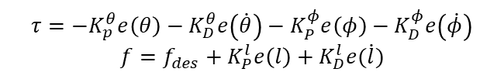
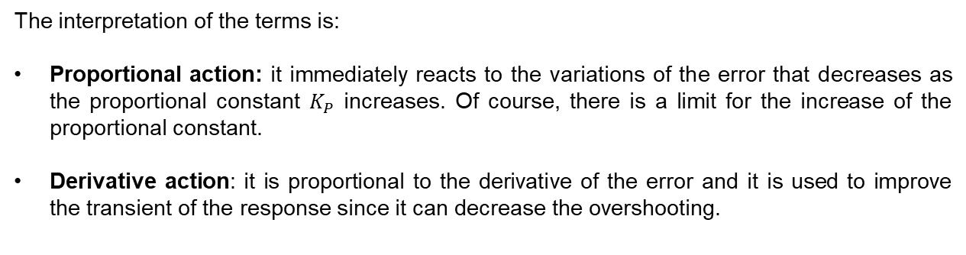
PD Controller
We want to control the robot during the balancing phase with a
Proportional Derivative controller
$$τ=−K_{p}^{θ}e\left(θ\right)−K_{D}^{θ}e\left(\dot{θ}\right)−K_{P}^{φ}e\left(φ\right)−K_{D}^{φ}e\left(\dot{φ}\right)$$
$$f=f_{des}+K_{P}^{l}e\left(l\right)+K_{D}^{l}e(\dot{l})$$
The interpretation of the terms is:
Proportional action: it immediately reacts to the variations of the error that decreases as the proportional constant $K_{P}$ increases. Of course, there is a limit for the increase of the proportional constant.
Derivative action: it is proportional to the derivative of the error and it is used to improve the transient of the response since it can decrease the overshooting.

Slide 9



Experiments
The simulations have been implemented in Python using the acados solver.

Slide 10
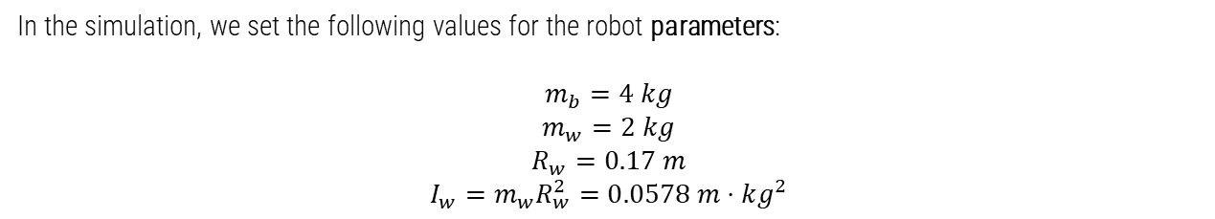
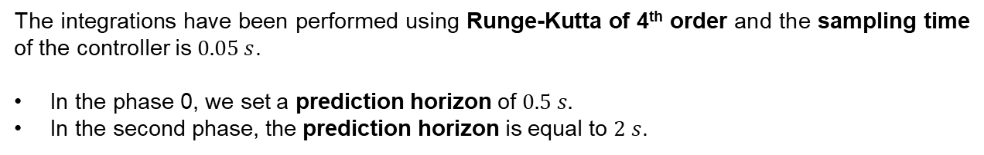
Jumping over a gap (MPC)
In the simulation, we set the following values for the robot parameters:
$$m_{b}=4 kg$$
$$m_{w}=2 kg$$
$$R_{w}=0.17 m$$
$$I_{w}=m_{w}R_{w}^{2}=0.0578 m⋅kg^{2}$$
The integrations have been performed using Runge-Kutta of 4th order and the sampling time of the controller is $0.05 s$.
In the phase 0, we set a prediction horizon of $0.5 s.$
In the second phase, the prediction horizon is equal to $2 s$.

Slide 11
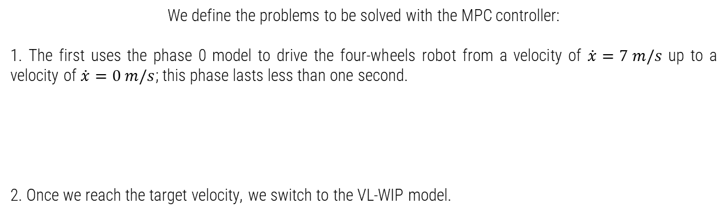
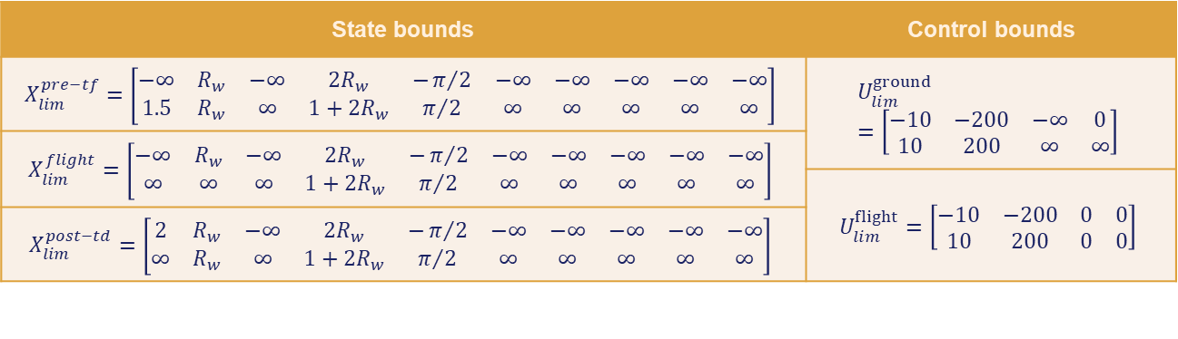
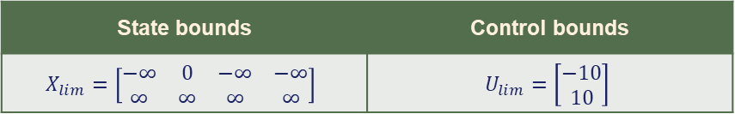
Jumping over a gap (MPC)
We define the problems to be solved with the MPC controller:
1. The first uses the phase 0 model to drive the four-wheels robot from a velocity of $\dot{x}=7 m/s$ up to a velocity of $\dot{x}=0 m/s$; this phase lasts less than one second.
2. Once we reach the target velocity, we switch to the VL-WIP model.
State bounds | Control bounds
$$X_{lim}=\left[\begin{matrix}−∞ & 0 & −∞ & −∞ \\ ∞ & ∞ & ∞ & ∞\end{matrix}\right]$$ | $$U_{lim}=\left[\begin{matrix}−10 \\ 10\end{matrix}\right]$$
State bounds | Control bounds
$$X_{lim}^{pre−tf}=\left[\begin{matrix}−∞ & R_{w} & −∞ & 2R_{w} & −π/2 & −∞ & −∞ & −∞ & −∞ & −∞ \\ 1.5 & R_{w} & ∞ & 1+2R_{w} & π/2 & ∞ & ∞ & ∞ & ∞ & ∞\end{matrix}\right]$$ | $$U_{lim}^{ground}=\left[\begin{matrix}−10 & −200 & −∞ & 0 \\ 10 & 200 & ∞ & ∞\end{matrix}\right]$$
$$X_{lim}^{flight}=\left[\begin{matrix}−∞ & R_{w} & −∞ & 2R_{w} & −π/2 & −∞ & −∞ & −∞ & −∞ & −∞ \\ ∞ & ∞ & ∞ & 1+2R_{w} & π/2 & ∞ & ∞ & ∞ & ∞ & ∞\end{matrix}\right]$$
 | $$U_{lim}^{flight}=\left[\begin{matrix}−10 & −200 & 0 & 0 \\ 10 & 200 & 0 & 0\end{matrix}\right]$$
$$X_{lim}^{post−td}=\left[\begin{matrix}2 & R_{w} & −∞ & 2R_{w} & −π/2 & −∞ & −∞ & −∞ & −∞ & −∞ \\ ∞ & R_{w} & ∞ & 1+2R_{w} & π/2 & ∞ & ∞ & ∞ & ∞ & ∞\end{matrix}\right]$$

Slide 12
Jumping over a gap (MPC)
The robot has first to drive horizontally on four wheels, then it should get up and balance on two wheels, drive forward and finally jump over a gap. A two stage controller is used to switch from one model to the other.
Control variables
State variables

Slide 13
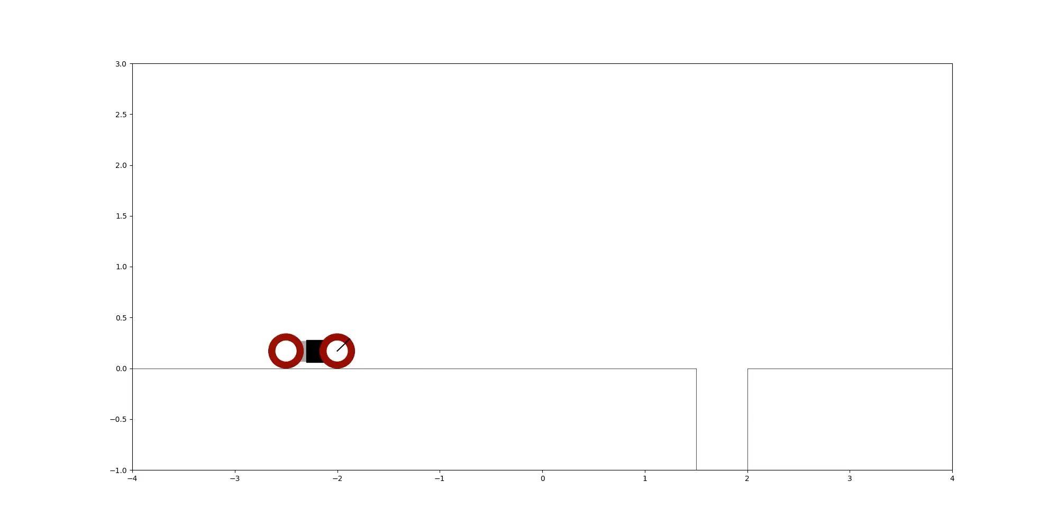
Jumping over a gap (MPC)
The robot contracts its body by restricting the prismatic joint before the take-off and then extends it before approaching the ground again.

Slide 14
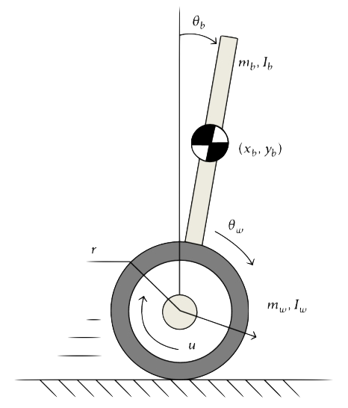
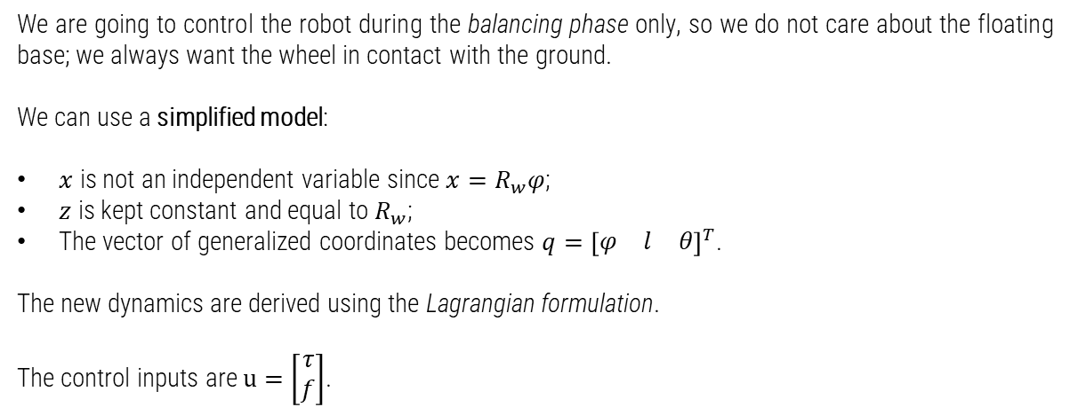
PD vs MPC – simplified model
We are going to control the robot during the balancing phase only, so we do not care about the floating base; we always want the wheel in contact with the ground.
We can use a simplified model:
$x$ is not an independent variable since $x=R_{w}φ$;
$z$ is kept constant and equal to $R_{w}$;
The vector of generalized coordinates becomes $q={\left[\begin{matrix}φ & l & θ\end{matrix}\right]}^{T}$.
The new dynamics are derived using the Lagrangian formulation.
The control inputs are $u=\left[\begin{matrix}τ \\ f\end{matrix}\right]$.

Slide 15
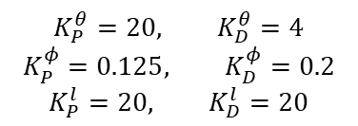
PD vs MPC – results
We compare the results for the balancing phase, from $q_{i}=\left[\begin{matrix}0 & 0.5 & \frac{π}{8}\end{matrix}\right]$ to $q_{f}=\left[\begin{matrix}−\frac{2}{R_{w}} & 0.8 & 0\end{matrix}\right]$.
We plot the whole state variables knowing that $x=R_{w}φ$ and $z=R_{w}$
PD
results
$$K_{P}^{θ}=20, K_{D}^{θ}=4$$
$$K_{P}^{φ}=0.125, K_{D}^{φ}=0.2$$
$$K_{P}^{l}=20, K_{D}^{l}=20$$
State variables
Control variables

Slide 16
PD vs MPC – results
We compare the results for the balancing phase, from $q_{i}=\left[\begin{matrix}0 & 0.5 & \frac{π}{8}\end{matrix}\right]$ to $q_{f}=\left[\begin{matrix}−\frac{2}{R_{w}} & 0.8 & 0\end{matrix}\right]$.
We plot the whole state variables knowing that $x=R_{w}φ$ and $z=R_{w}$
MPC
results
State variables
Control variables

Slide 17
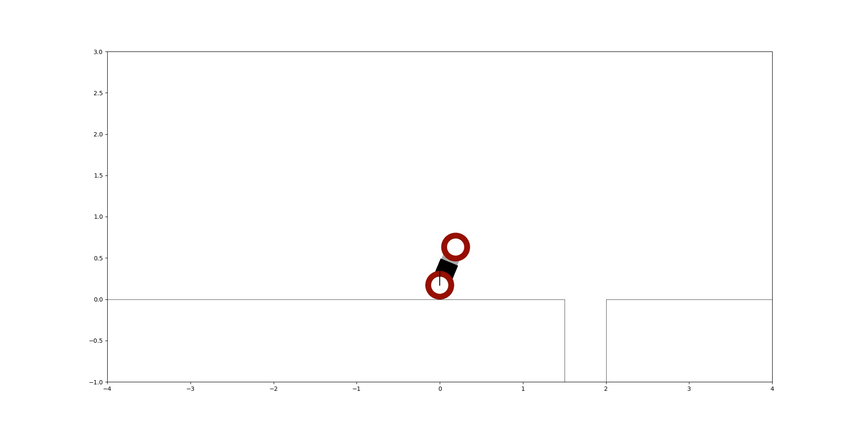
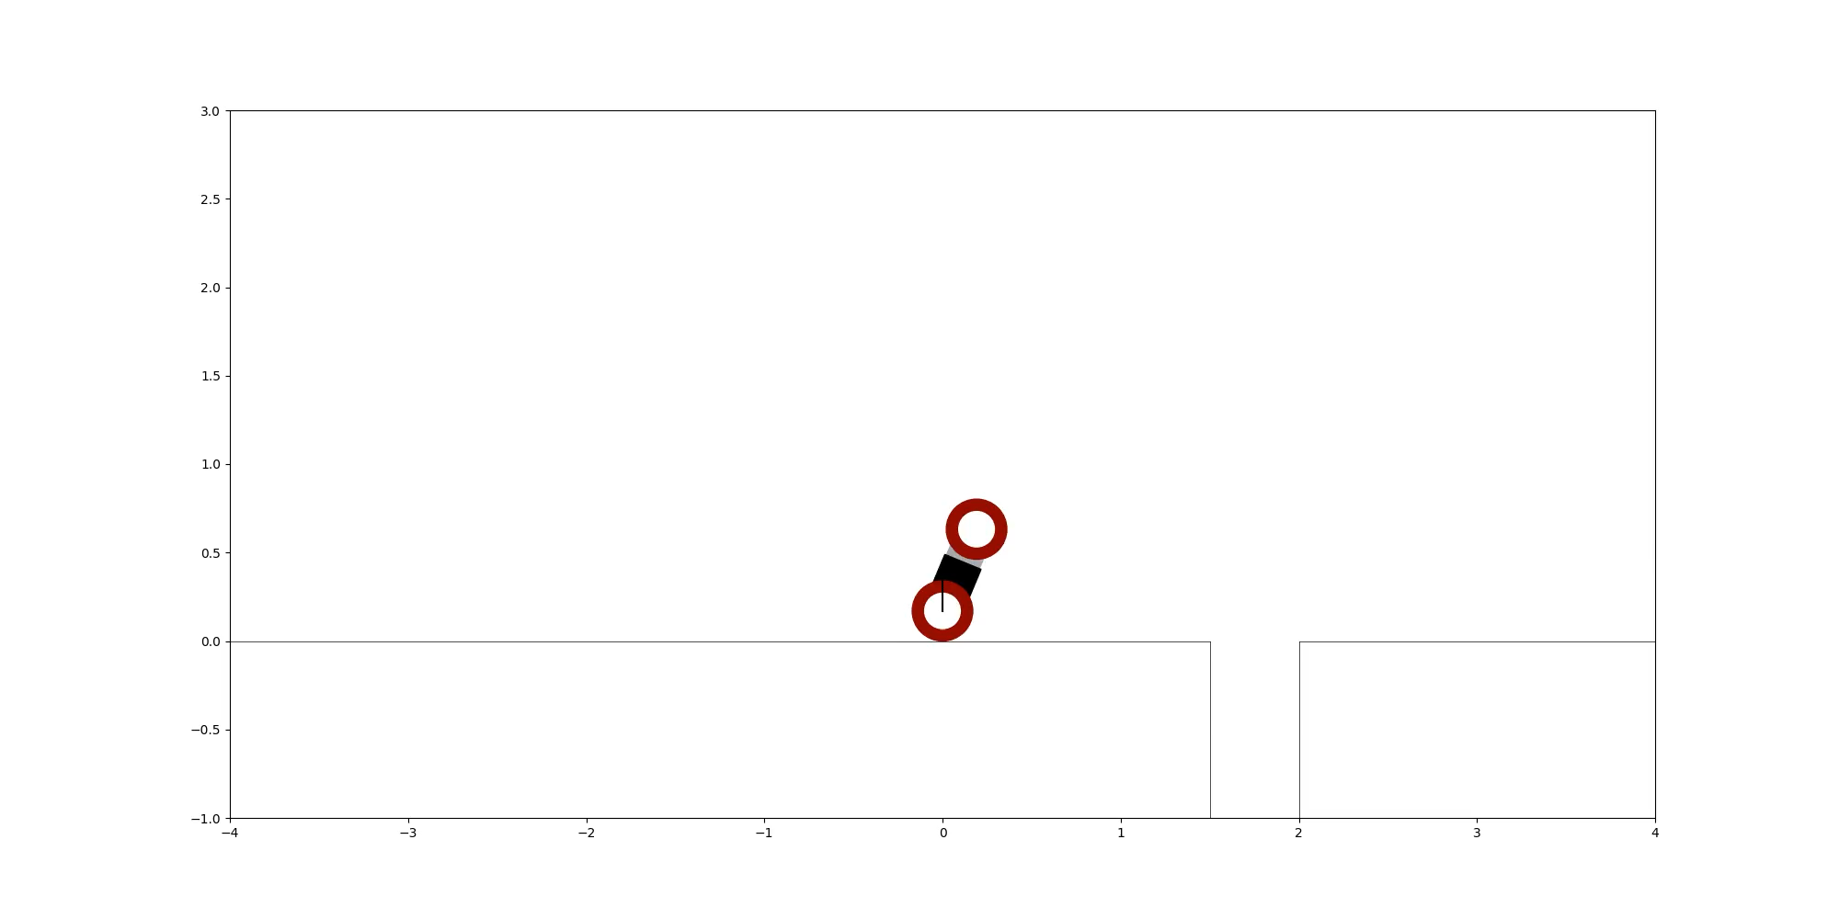
PD vs MPC – results
PD
MPC

Slide 18

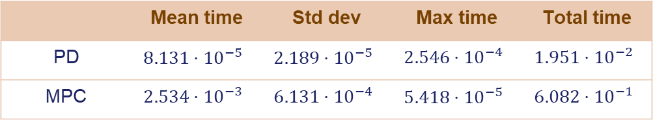
PD vs MPC – computational time
We want to compare the computational times for the two controllers considering:
Mean time: mean time value among all the iterations
Std dev: standard deviation among all the iterations
Max time: time that the slowest iteration needs to finish
Total time: time needed to execute 12 s of simulation
 | Mean time | Std dev | Max time | Total time
PD | $$8.131⋅{10}^{−5}$$ | $$2.189⋅{10}^{−5}$$ | $$2.546⋅{10}^{−4}$$ | $$1.951⋅{10}^{−2}$$
MPC | $$2.534⋅{10}^{−3}$$ | $$6.131⋅{10}^{−4}$$ | $$5.418⋅{10}^{−5}$$ | $$6.082⋅{10}^{−1}$$
MPC is slower than PD controller!

Slide 19

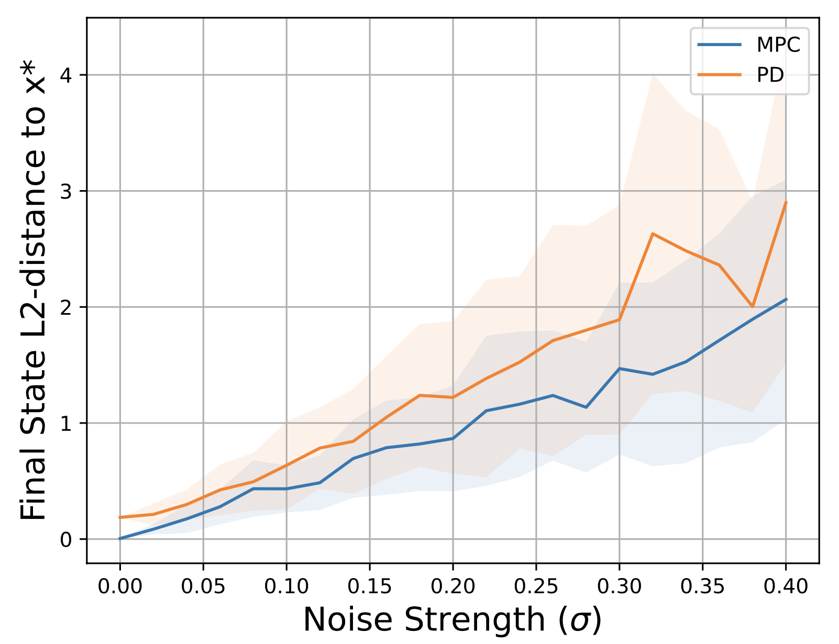
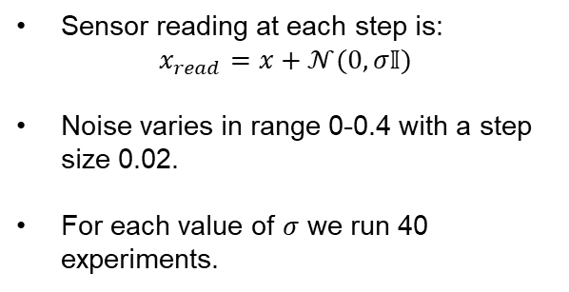
Extension: noise on sensor’s reading
We added noise on sensor’s reading both on MPC and PD for the balancing phase.
Sensor reading at each step is:
$$x_{read}=x+𝒩(0,σ𝕀)$$
Noise varies in range 0-0.4 with a step size 0.02.
For each value of $σ$ we run 40 experiments.

Slide 20
Conclusions
Despite its very simple dynamics, the VL-WIP is able to generate complex motions.
MPC allows to control it in a precise way, obtaining high accuracy motions throughout all the phases.
We can also use a PD controller, but we have to tune gains in an empirical way.
With the MPC we can obtain even more difficult tasks (as jumping) in an easier way; however, the computational times are higher.
MPC is more robust than PD controller since it is less sensible to noise.

Slide 21

Thank you for listening!

